Slide 1
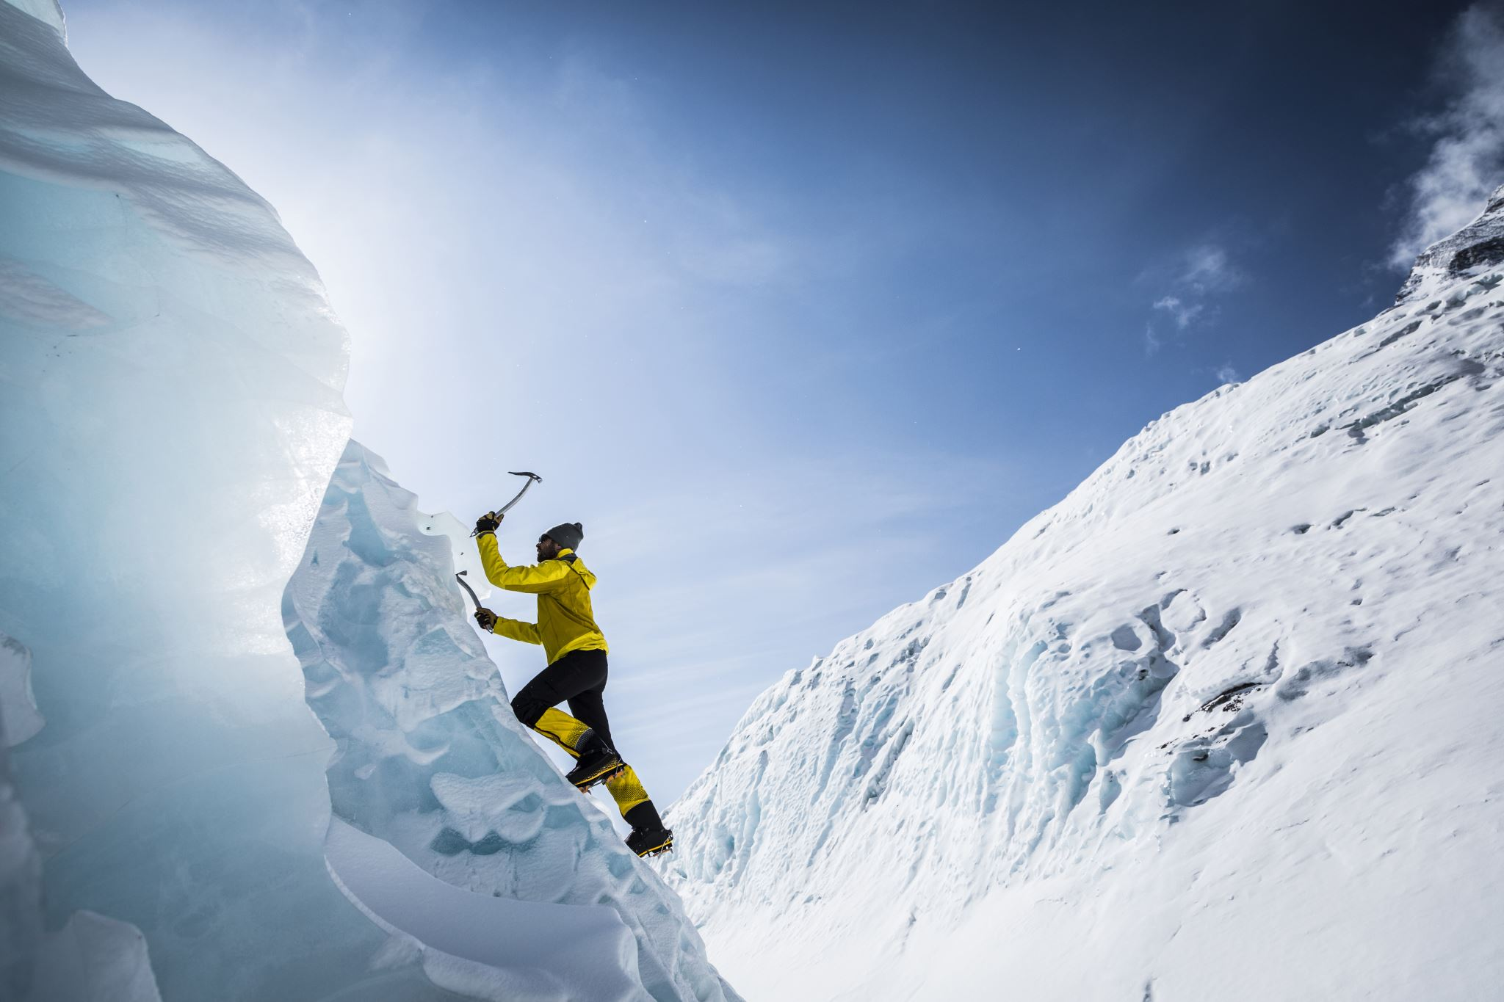
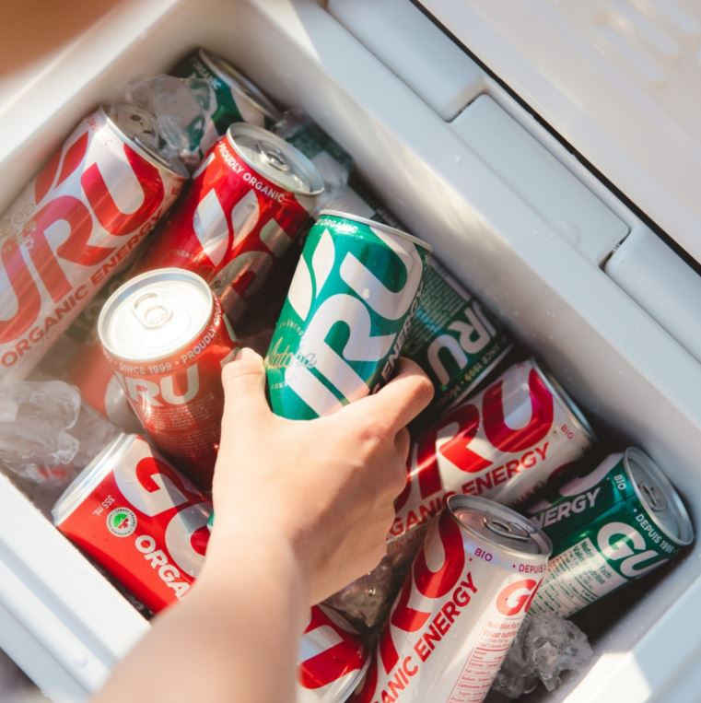





“Guru is a breath of fresh air to the Energy Drink Energy”
Claude
Raphael
Nowaisir
Jonathan
OM PARTNERS

Slide 2
Recommendation
Clean up the energy drink industry ‘one can' at a time. ​
Recommendation: BUY Price Target: $36.57 Current Price: $22.30 Upside: 64%
Investment Recommendation
Stock Price Guru (red) vs. S&P/TSX 60 – 1Y
Only pure organic business in the energy drink space
Expansion in California is key to generating future value to shareholders
We believe that Guru can follow a similar growth trajectory as other successful peers like Monster (66,690%)and Celsius (5,350%)
260%
10%
Investment Highlights
Recommendation & Valuation Summary
California leading the U.S. expansion. TAM valued at $11.3B forecasted to grow at a compound growth rate of 8.1% to 2025
Fostering Brand Loyalty. Guru’s 2-step marketing has a been a driving force behind its performance. It is on path to replicate this success in California
Buy an OTM call option, with a $30 strike and 1 year to maturity. To increase our current exposure without tying up more capital and increase our risk
FY-21 EV/EBITDA 274.64x
WACC: 7.92%
FY-21 EPS: 0.05$
FY-21 Revenue: $28.4M

Slide 3









Company Analysis
Company Overview
Company Highlights
Strong Senior Management
History: GURU is a Montréal based beverage company that pioneered the world's first natural plant-based energy drink in 1999 with 50 employees.
Mission : Clean up the energy drink industry 'one can' at a time.
Healthy ingredients: GURU is composed of ingredients such as Green tea, Guarana, Ginseng, Echinacea Matcha, Monk Fruit and Stevia.
Carl Goyette
President and CEO
More than 20 years of experience in sales and marketing strategic planning leading to tripling sales of GURU profitably over the last 5 years
Joe Zakher
Founder and Executive Chairman
This seasoned entrepreneur had launched various companies including being the driving force behind one of Montreal's most renowned EDM music venues
x
x
x
x
No synthetic caffeine
No energy crashes
Certified organic
Plant-based ingredients
No artificial sweeteners
Taurine
Caffeine content (per 12oz can) | 140mg per 12oz can | 114mg per 12oz can | 160mg per 16oz can | 160mg per 16oz can | 114mg per 12oz can
x
x
x
x
x
x
x
x
Alain Miquelon
Lead Director, Chair of Governance and Compensation Committee
Senior Partner, Novacorp
Over 20 years of experience as senior officer of public companies including being President and CEO of the Montreal Exchange Inc.
x
x
x
x
x
x
x
x
x

Slide 4
Company Analysis
Business Model
Industry Value Chain
Operations: Producer & Retailer
Sales Mix: Expanding US operations is key to growth
GURU is a producer and a retailer.
It outsources the distribution and warehousing logistics through third-parties
Producing
GURU
DistributorThird-parties
Retailing GURU
Eliminating the risk by outsourcing the middle channel
Being in control of retail means they can leverage ecommerce sales channels – direct B2C

Slide 5




Company Analysis
Strategic Growth Objectives
Channels
Details
Total Addressable Market
(TAM)
Aims to double market share in four years
Executing in-store to build their brand block
$180M
QUEBEC
Aims to reach 10% market shares in five years
$416M
Plan to inrease exposure to 3,000 to 6000 C&G outlets in rest of Canada
CANADA
GROCERY & MASS
Aim to advertise on banners to increase public exposure
DRUG CHANNEL
Targeted banners will ensure conveying their focus on health and wellness
CALIFORNIA
$11.3B
BRAND BUILDING CHANNELS
Targeting food service, outdoors and food service
Through continual re-investing to acquire more customers will increase their base
$1B
ONLINE
Existing customers will be driving the growth in this channel

Slide 6
Industry Analysis
Energy Drinks industry in Canada and the United States
Current Industry
In 2018, non-alcoholic segment is expected to dominate in Canada and grow with a compounded annual growth rate of 12%
Similarly, organic segment is expected to grow at the highest compounded annual rate of 12.2%
$15B US energy drink industry market in 2019 expected to grow at 8.1% CAGR through 2025
8.1% CAGR
Macroeconomics Fundamentals
US Federal Reserve forecasts 2-3% producer price inflation through 2024
Rising commodity costs could dampen margin across the industry

Slide 7
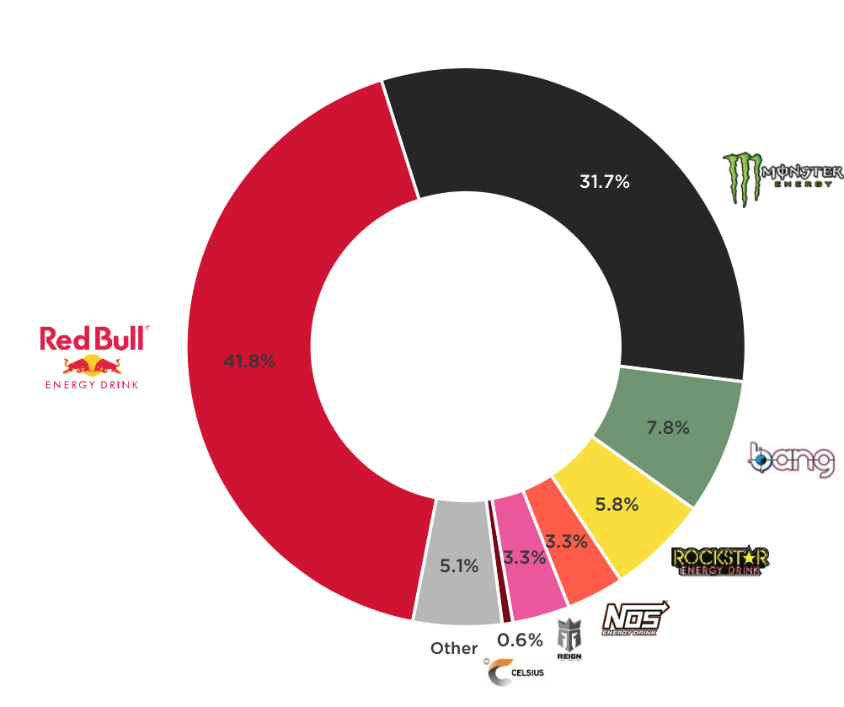



Industry Analysis
Competitive Landscape
Key Takeaway
$15bn US energy drink market share
Saturated market with 3 players representing 70% of total market share
Most do not satisfy the organic & sustainable lifestyle
Tremendous market penetration opportunity
Competition & Brand Positioning
Redbull: Associating itself Extreme sports
Celsius: most closely mimics the Guru branding of active lifestyle
Monster associating itself with action sports, punk rock music
Rockstar with its variety of drinks offered and standout 'sweet' taste has been growing.

Slide 8

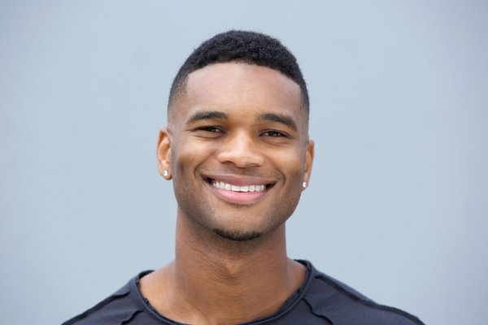
Investment Thesis
Meeting the demands of millennials & gen z
Organic Food Sales ($B)
The only plant-based & organic energy drink. Guru caters to the demands of Millennials and Gen Z as the largest consumers of organic foods.
42% growth in 5 years
Sam
21, Student
Enjoys Guru while studying. Actively purchases organic label products.
Joseph
27, Manager
Consumes Guru while working out. Wants a natural energy drink without getting jitters.
Meeting the demands of their target demographic has led 3x sales growth in the past 5 years
High retention ratio:
82% of amazon orders are repeat customers

Slide 9
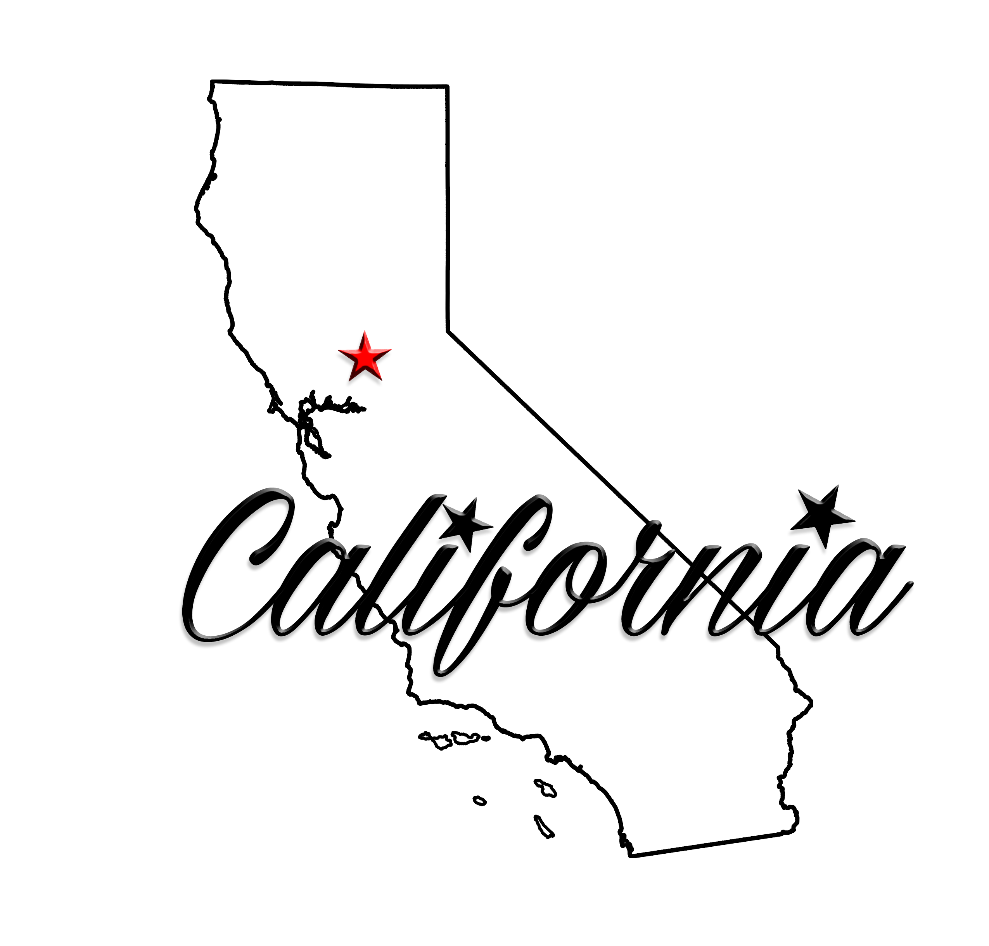
Investment Thesis
Scaling their winning business model to a larger market
Larger TAM:
Quebec: $180M
US: $11B
Entering a market 60x larger with a proven formula
Larger Appetite:
Americans consume 6x more energy drinks per capita compared to Canadians
Gas Stations & Convenience stores are a $35B industry in California. This is Guru’s main focus.

Slide 10
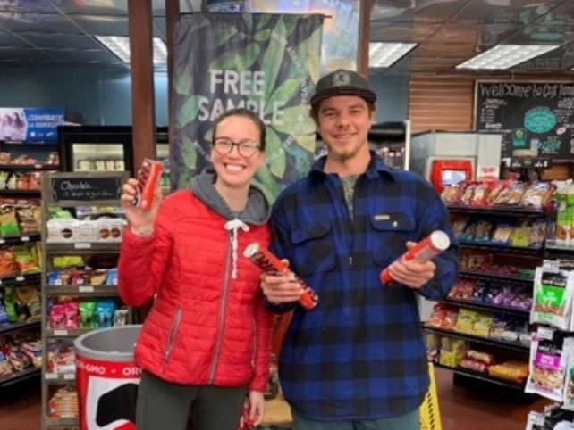
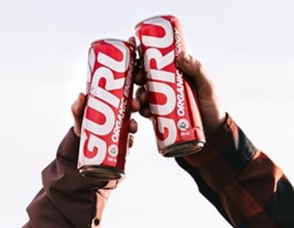
Investment Thesis
A winning strategy in a larger market
Two-step strategy:
How Guru differentiates itself
Bringing Guru’s strategy to California
Step 1:
Interact with consumers
Step 2:
Brand Awareness
Largest organic energy brand in Canada and 3rd largest brand in Quebec
Early signs of success:
Guru is the fastest growing energy drink brand in California convenience stores

Slide 11
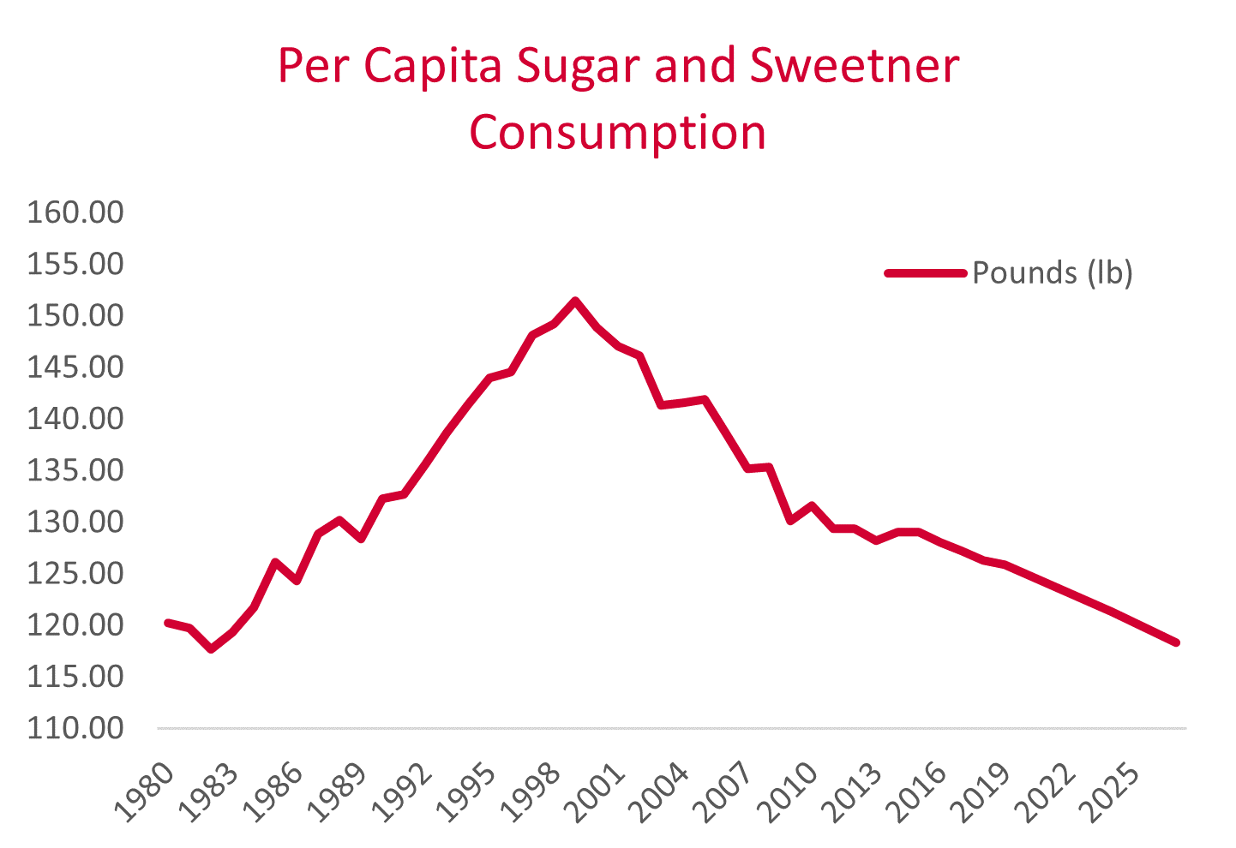
Investment Thesis
U.S. Beverage Industry Trends
Analysis
Plant-based foods sales ($B)
Decrease in the per capita sugar and sweetener consumption
Plant-based food products grew 5x faster than total food sales in US

Slide 12
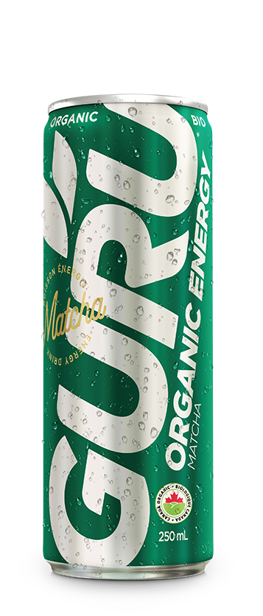
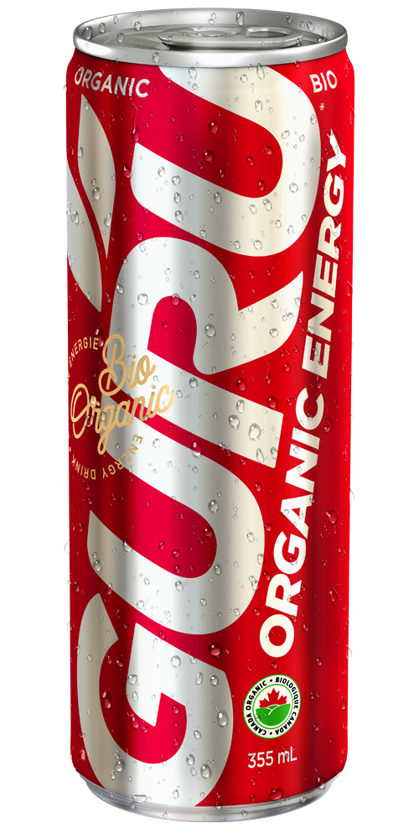
Can Economics
How much cans sold?
Estimates & Margin
Cans Sold
Merchant Retail Price
Bulk discount: 20% (355ml), 30% (250ml)
Inflation rate: 2%
Compound growth rate: +4% (2021-2026), -8% (2026-2030)
x2
-Discount%
2017-2020
Revenue per can
X Inflation rate
2.35M (355 ml cans)
4.75M (250ml cans)
Number of cans sold
1.9M (250ml cans)
3.8M (355 ml cans)
X Growth rate
Forecast

Slide 13
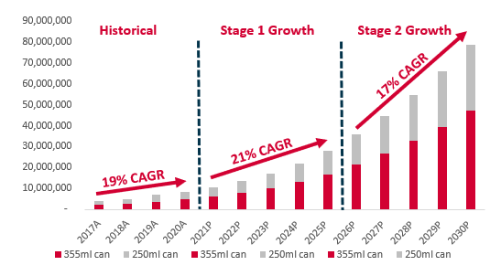
Can Economics
Goal: 80 million cans sold in 2030
What will help GURU to achieve this?
Lower production costs through Economies of scale
Increase of the ratio of marketing dollars spent per cans sold from $0.91 to $0.99
Higher Volume, Lower Margin
Even at 17% CAGR, in 2030, this represents a 0.3% of the TAM projected
GURU IS POSITIONED TO INCREASE ITS MARKET SHARE THANKS TO STRONG BRANDING AND EFFECTIVE MARKET POSITIONING

Slide 14
Valuation Assumptions
Forecasts
U.S, CAN and Amazon TAM vs Guru Penetration
EBITDA Forecast (in thousands)
Avg. Revenue and Marketing Spent per Can
Unlevered Free Cash Flow Forecast
~30% Margin
~35% Margin

Slide 15
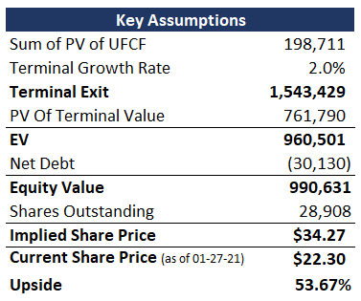
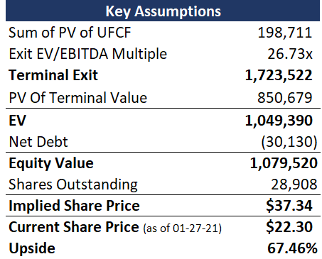
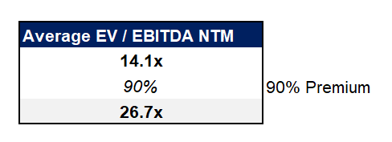
Valuation
DCF & Multiples Valuation
DCF Valuation
Multiples Valuation

Slide 16
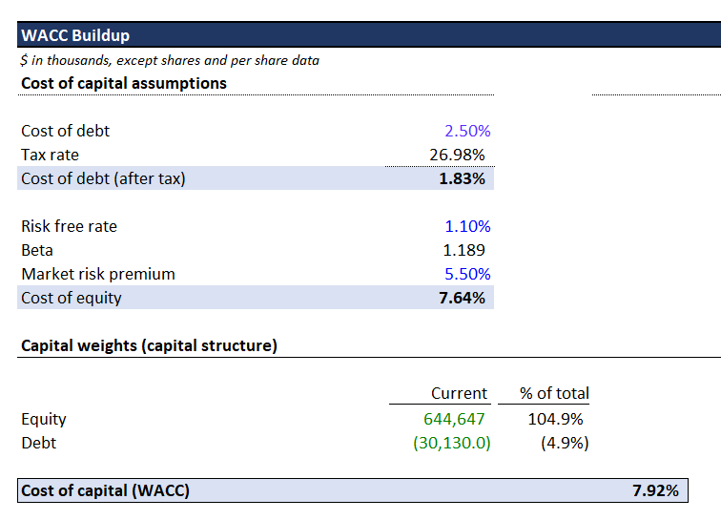
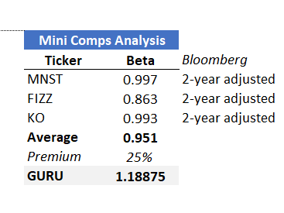
Valuation Assumptions
Discounted Cash Flow Model
Discount Rate

Slide 17
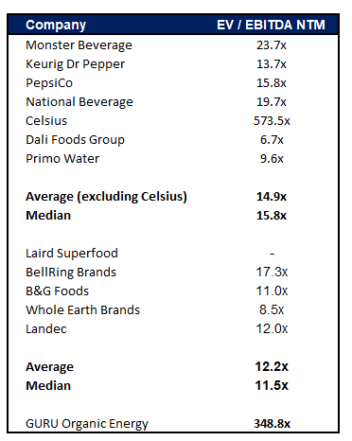
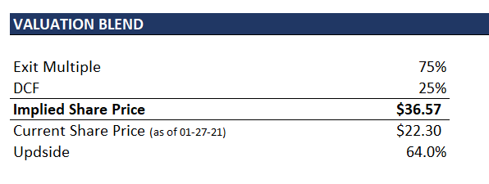
Final Valuation
75% Exit Multiple-based Approach, 25% DCF
Valuation Blend
Comparable Multiples
Pure Plays
Secondary Companies
More weight on Pure Plays

Slide 18
Risks & Mitigation
Risks to the valuation
Severity
Risks
Mitigation
US expansion fails
Synergies aren’t materialized in California
Re-shift focus to e-commerce and Amazon sales
High
Mid
Oversaturated market
Many competing natural energy drinks
Strong branding and niche target market
Difficult Comparables
Valuation may be skewed
Emphasis on moat & focus on DCF valuation
Mid
Low
Commodity Prices
Ex. Rising prices of Stevia and Matcha
Hedging commodities & strong consumer loyalty to absorb price increase

Slide 19


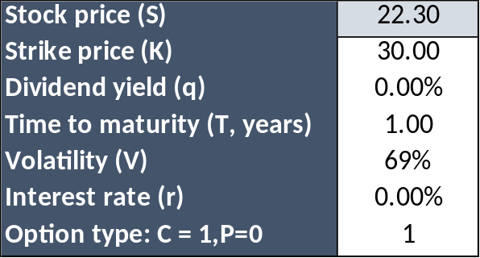
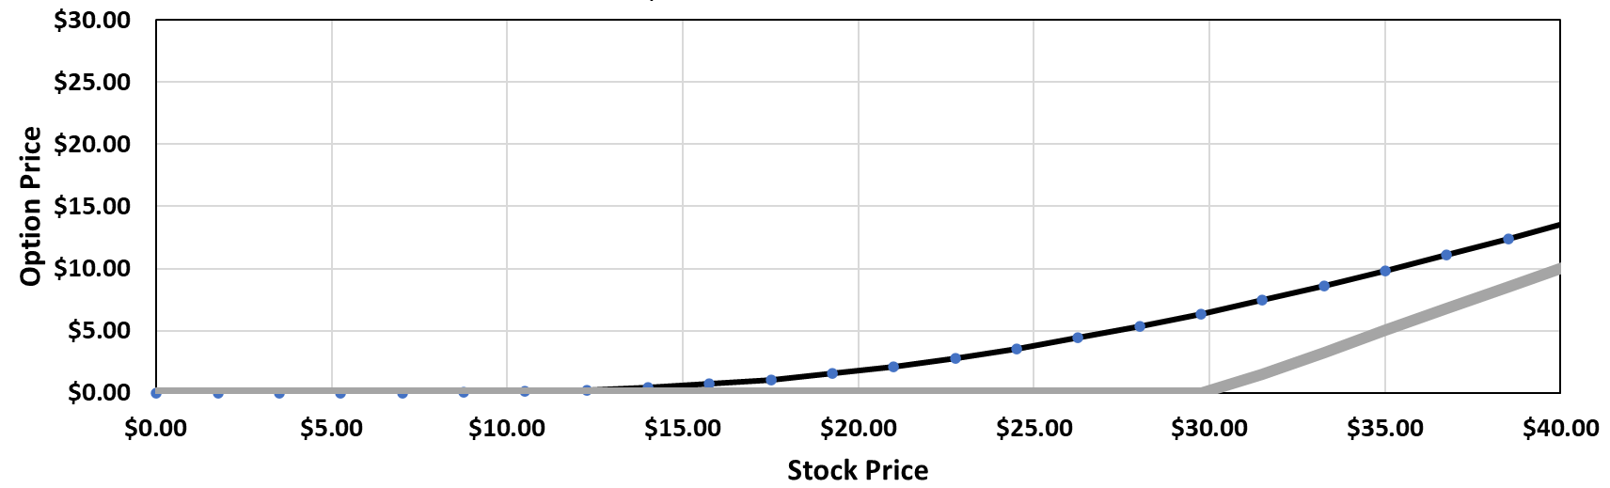
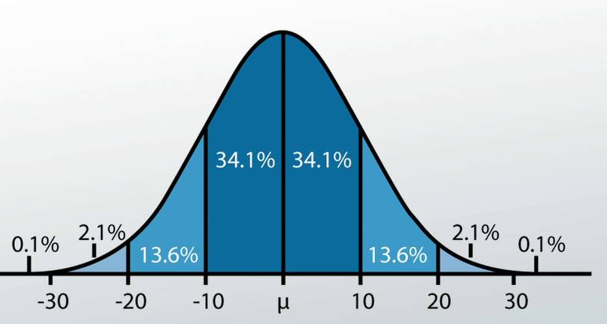
Recommendation
A call option allows to benefit from leverage & a well-defined risk-return profile
Recommendation: BUY Current Price: $22.30 1-Year Price Target: $36.57 Upside: 64%
P&L at different 1-year price outcomes
Black Scholes Model Assumptions – 1Y
$0.00
$24.90
$36.57
Call: $ 2.26
With Option
-$2.6
$0
$4.31
$ 6.91
-100%
0%
+190%
$22.30
No Option
-$22.30
$2.60
$14.27
$36.57
-100%
10.1%
64%
Call option is priced as if there is a 68% probability Guru could hit price target of $36.57
Bear
Base
Bull
We do not believe Guru returns are normally distributed!

Slide 20
Q&A
Thank you

Slide 21
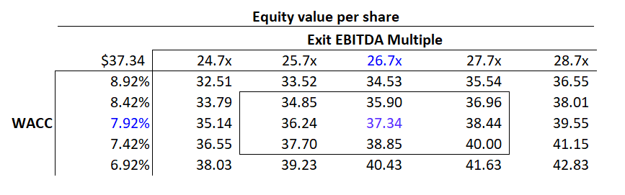
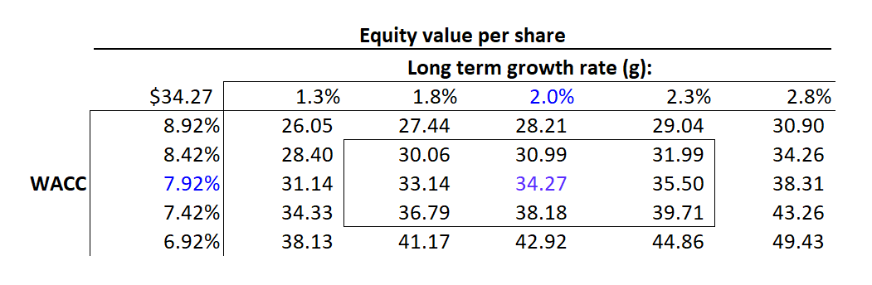
Appendix – Sensitivity Analysis

Slide 22
Appendix - Comps
Company | Currency | Mkt Cap ($mm) | Price to Sales | Sales Growth 3yrs | EV / EBITDA NTM | EBITDA Margin | EV ($mm) | Sales ($mm) | Sales per Employee | EV/Sales Growth | Sale Growth 1 yr | EV / Sales / Growth
Monster Beverage | USD | 47,262 | 9.07x | 33.2 | 23.7x | 37% | 44909.9 | 5,947 | 1,685,123 | 7.6x | 8% | 96.1
Keurig Dr Pepper | USD | 45,162 | 3.69x | 72.5 | 13.7x | 34% | 59082.3 | 15,381 | 603,180 | 3.8x | 5% | 83.2
PepsiCo | USD | 193,459 | 2.60x | 7.9 | 15.8x | 20% | 226503 | 92,262 | 345,552 | 2.5x | 4% | 66.7
National Beverage | USD | 4,612 | 4.17x | 15.4 | 19.7x | 23% | 4225.9 | 1,414 | 912,000 | 3.0x | 6% | 50.7
Celsius | USD | 4,984 | 26.71x | 258.1 | 573.5x | 10% | 4592.3 | 160 | 1,336,667 | 28.6x | 73% | 39.4
Dali Foods Group | USD | 8,373 | 2.31x | 5.7 | 6.7x | 26% | 6486.7 | 3,896 | 102,586 | 1.7x | 10% | 16.5
Primo Water | CAD | 2,638 | 1.23x | -39.8 | 9.6x | 18% | 4077.5 | 2,753 | 237,703 | 1.5x | -21% | -6.9
Average | - | 43,784 | 7.1 | 50.4 | 94.7x | 24% | 49,982.5 | 17,401.8 | 746,116 | 6.9x | 12% | 49.4
Median | - | 8,373 | 3.7 | 15.4 | 15.8x | 23% | 6,486.7 | 3,895.7 | 603,180 | 3.0x | 6% | 50.7
GURU Organic Energy | CAD | 639 | 19.01x | 114.5 | 348.8x | 6.9% | 639.1 | 22.1 | 401,818 | 28.9x | 37% | 78.9
Company | Currency | Mkt Cap ($mm) | Price to Sales NTM | EV / EBITDA | EBITDA Margin | Sales ($mm) | Sales per Employee | EV / Sales | Sale Growth 1 yr | EV / Sales / Growth
Laird Superfood | USD | 528 | 0.6x | - | -22% | 30.8 | - | 12.6x | 6% | 201.8x
BellRing Brands | USD | 4,254 | 2.9x | 17.3x | 20% | 1,329.8 | 3,409,782 | 5.9x | 11% | 51.5x
B&G Foods | USD | 2,493 | 1.0x | 11.0x | 19% | 2,594.0 | 894,798 | 1.9x | 20% | 9.5x
Whole Earth Brands | USD | 593 | 1.0x | 8.5x | 19% | 180.1 | 45,021,023 | 4.0x | 105% | 3.8x
Landec | USD | 431 | 8.8x | 12.0x | 7% | 773.9 | 972,205 | 0.9x | -8% | -10.7x
Average | - | 1,660 | 2.9x | 12.2x | 8% | 982 | 12,574,452 | 5.0x | 27% | 51.2x
Median | - | 593 | 1.0x | 11.5x | 19% | 774 | 2,190,993 | 4.0x | 11% | 9.5x
GURU Organic Energy | CAD | 639 | 19.0x | 348.8x | 6.9% | 22.1 | 401,818 | 28.9x | 37% | 78.9x

Slide 23
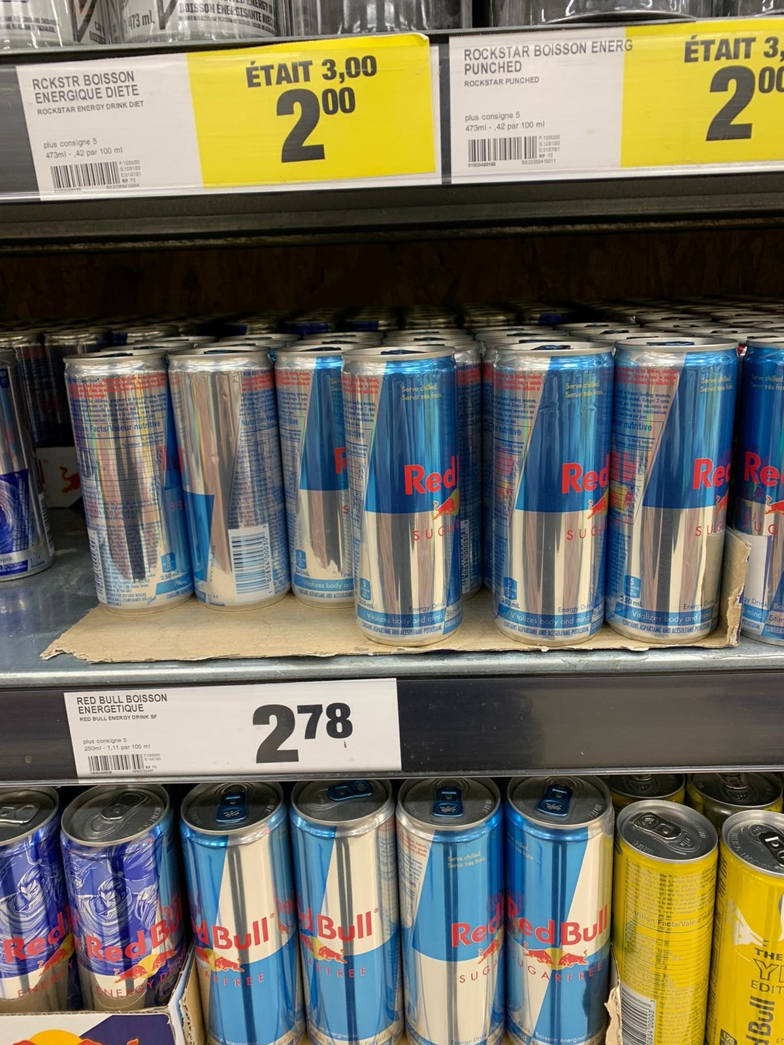
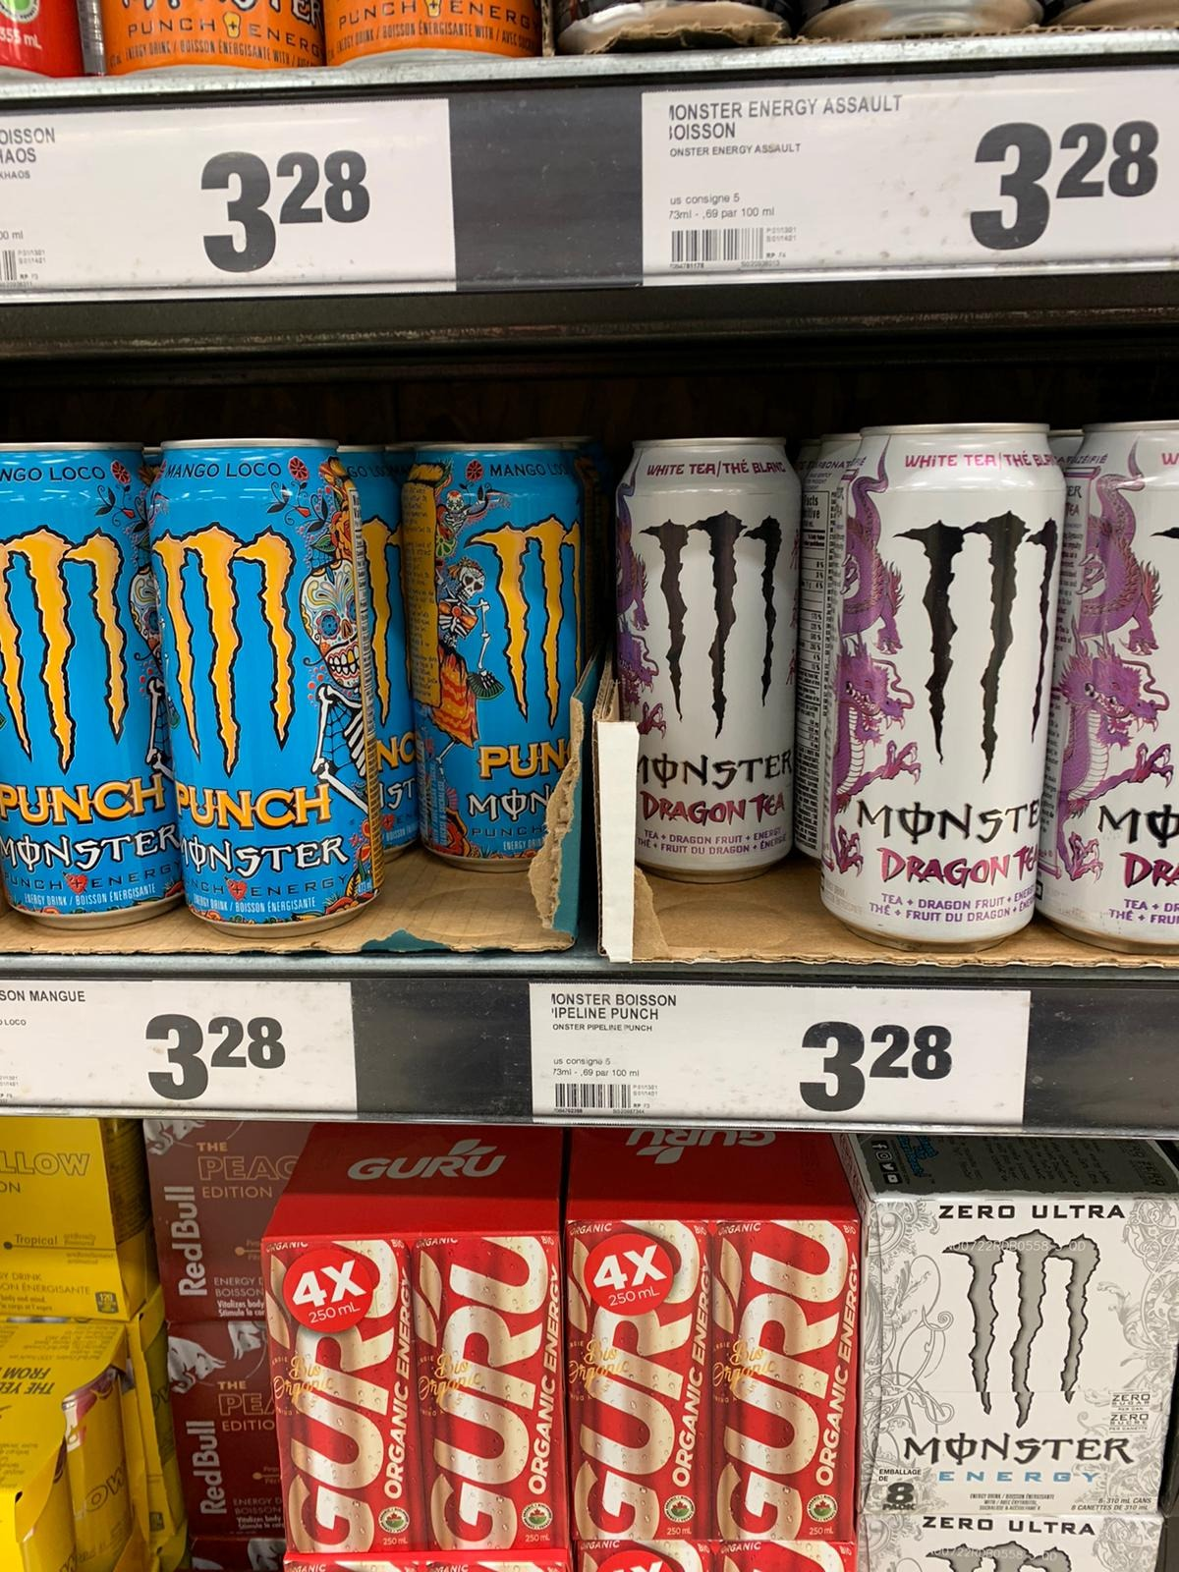
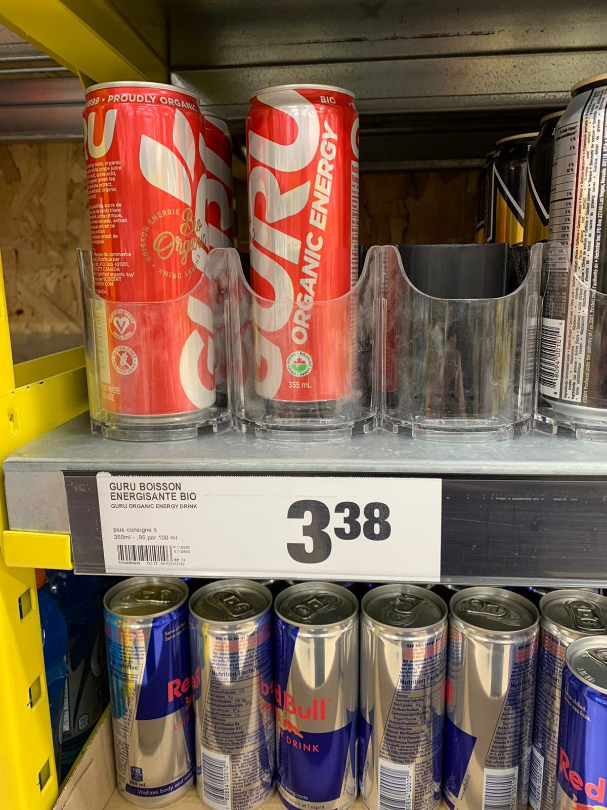
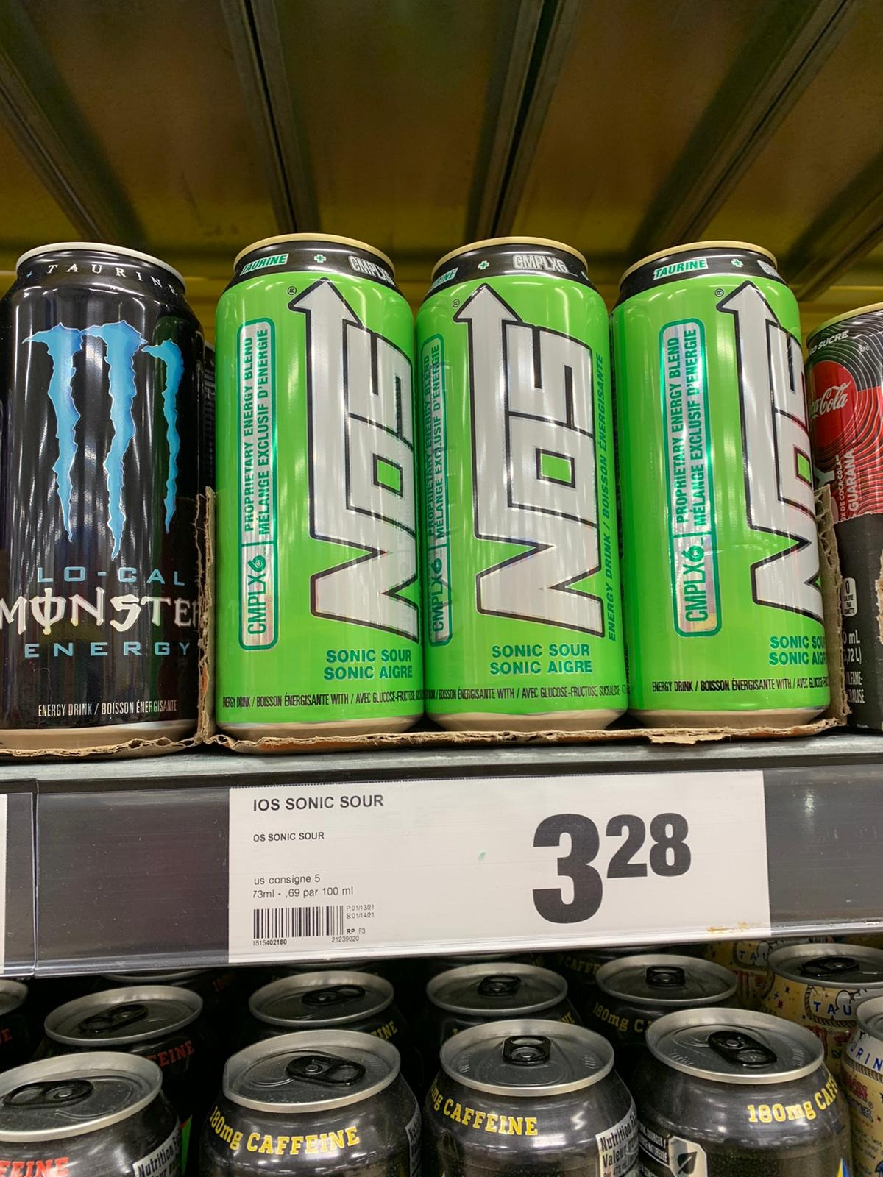
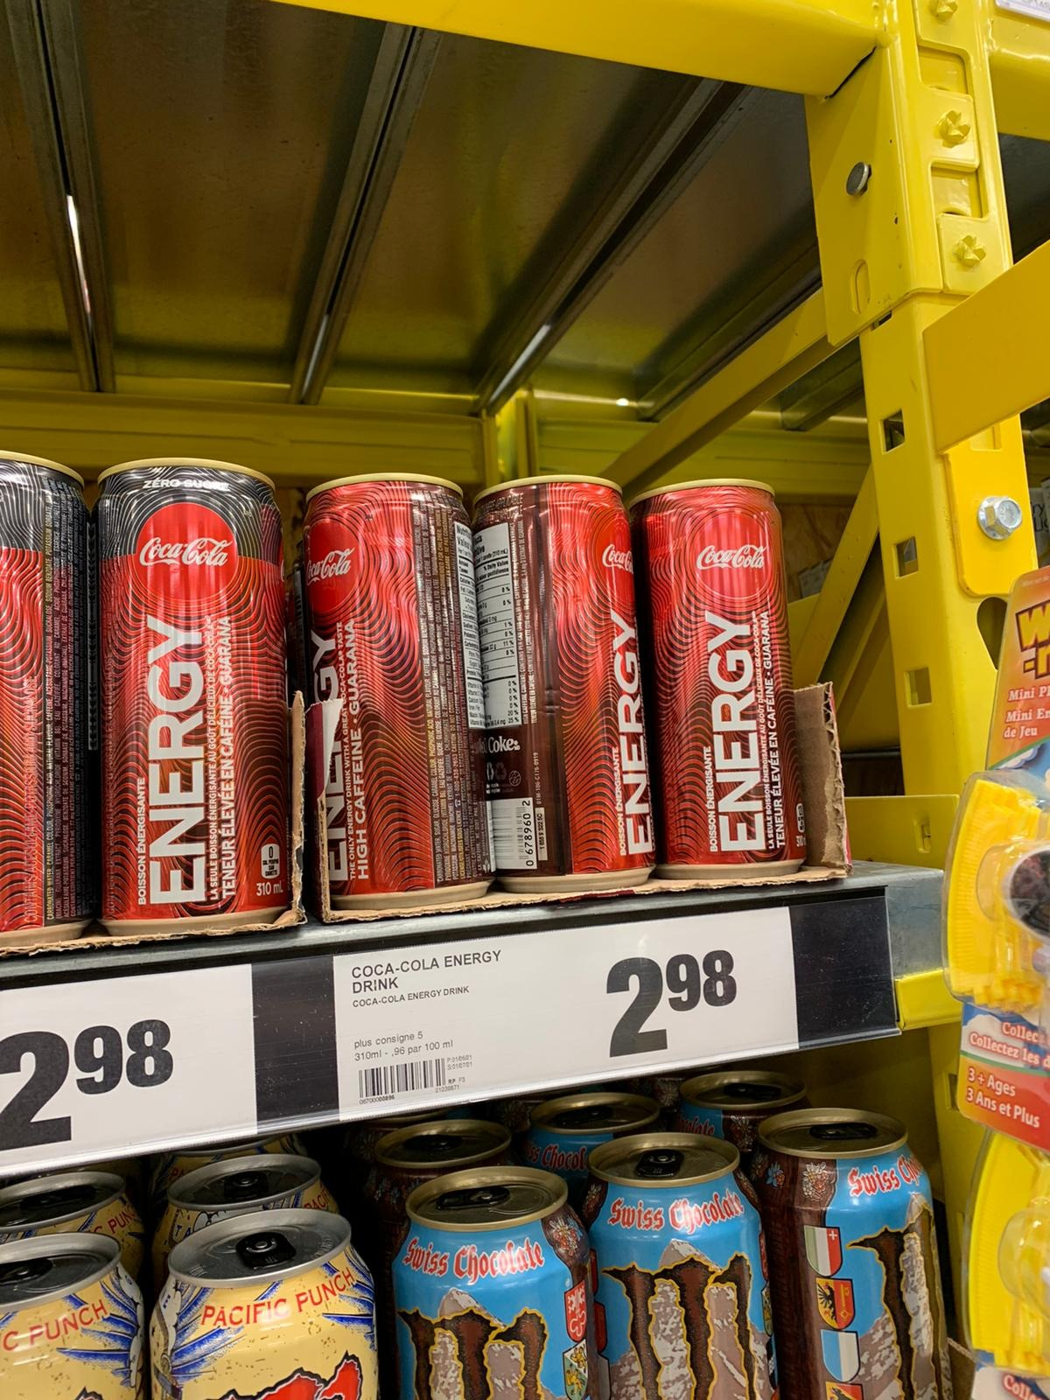
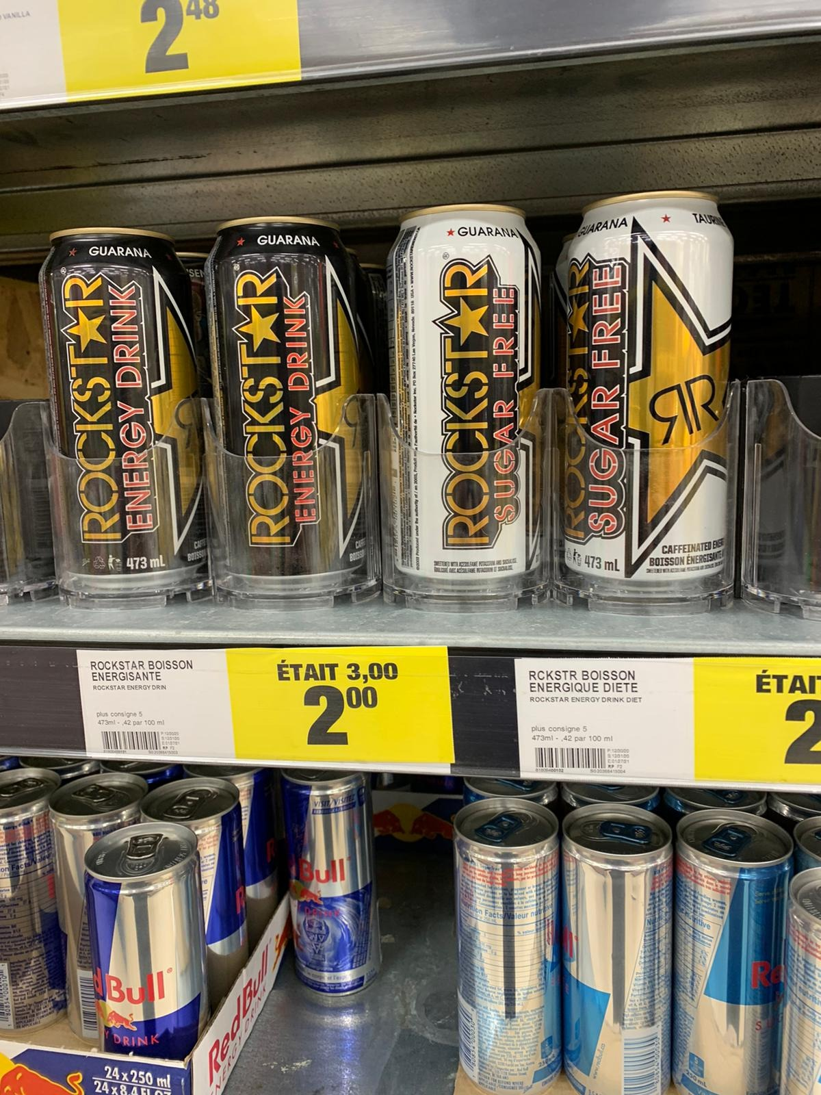
Appendix – Market Positioning

Slide 24
Appendix – Black-Scholes Basic Options Pricing Model

Slide 25
Works Cited
Company analysis
https://www.guruenergy.com/upload/investors/GURU-Investor-Presentation_EN_December2020.pdf
Investment Thesis
https://www.prnewswire.com/news-releases/millennials-and-organic-a-winning-combination-300332642.html
https://www.pinterest.ca/pin/511580838908988243/
https://www.clipartmax.com/download/m2i8b1G6A0H7m2Z5_guru-organic-energy-stickers-messages-sticker-0-guru-energy-organic-energy-drink/
https://plantbasedfoods.org/2019-data-plant-based-market/
https://my-ibisworld-com.lib-ezproxy.concordia.ca/us/en/industry-specialized/od4205/industry-outlook
https://my-ibisworld-com.lib-ezproxy.concordia.ca/us/en/industry-specialized/od4205/about
Can Economics
https://www.prnewswire.com/news-releases/millennials-and-organic-a-winning-combination-300332642.html
https://www.pinterest.ca/pin/511580838908988243/
https://www.clipartmax.com/download/m2i8b1G6A0H7m2Z5_guru-organic-energy-stickers-messages-sticker-0-guru-energy-organic-energy-drink/

